Slide 1
The Urantia Book
Paper 97 Evolution of the God Concept Among the Hebrews
Paper 97 - Video study group link part 1
Paper 97 - Video study group link part 2
Paper 96 - Yahweh - God of the Hebrews

Slide 2
We would like to give a special thanks to Don Estes for the use of the information from his Chart The Origin, History and Destiny of Universe Reality. We would also like to thank the creator of Encyclopedia Urantia for the use of his slides from that web site.

Slide 3
Paper 97 Evolution of the God Concept Among the Hebrews AUDIO VERSION
^{97:0.1} ^{(1062.1)} The spiritual leaders of the Hebrews did what no others before them had ever succeeded in doing—they deanthropomorphized their God concept without converting it into an abstraction of Deity comprehensible only to philosophers. Even common people were able to regard the matured concept of Yahweh as a Father, if not of the individual, at least of the race.

Slide 4
^{97:0.2} ^{(1062.2)} The concept of the personality of God, while clearly taught at Salem in the days of Melchizedek, was vague and hazy at the time of the flight from Egypt and only gradually evolved in the Hebraic mind from generation to generation in response to the teaching of the spiritual leaders. The perception of Yahweh's personality was much more continuous in its progressiveevolution than was that of many other of the Deity attributes. From Moses to Malachi there occurred an almost unbroken ideational growth of the personality of God in the Hebrew mind, and this concept was eventually heightened and glorified by the teachings of Jesus about the Father in heaven.

Slide 5
1. Samuel - First of the Hebrew Prophets AUDIO VERSION
^{97:1.1} ^{(1062.3)} Hostile pressure of the surrounding peoples in Palestine soon taught the Hebrew sheiks they could not hope to survive unless they confederated their tribal organizations into a centralized government. And this centralization of administrative authority afforded a better opportunity for Samuel to function as a teacher and reformer.

Slide 6
^{97:1.2} ^{(1062.4)} Samuel sprang from a long line of the Salem teachers who had persisted in maintaining the truths of Melchizedek as a part of their worship forms. This teacher was a virile and resolute man. Only his great devotion, coupled with his extraordinary determination, enabled him to withstand the almost universal opposition which he encountered when he started out to turn all Israel back to the worship of the supreme Yahweh of Mosaic times. And even then he was only partially successful; he won back to the service of the higher concept of Yahweh only the more intelligent half of the Hebrews; the other half continued in the worship of the tribal gods of the country and in the baser conception of Yahweh.

Slide 7
^{97:1.3} ^{(1062.5)} Samuel was a rough-and-ready type of man, a practical reformer who could go out in one day with his associates and overthrow a score of Baal sites. The progress he made was by sheer force of compulsion; he did little preaching, less teaching, but he did act. One day he was mocking the priest of Baal; the next, chopping in pieces a captive king. He devotedly believed in the one God, and he had a clear concept of that one God as creator of heaven and earth: " The pillars of the earth are the Lord's, and he has set the world upon them. "

Slide 8
^{97:1.4} ^{(1063.1)} But the great contribution which Samuel made to the development of the concept of Deity was his ringing pronouncement that Yahweh was changeless, forever the same embodiment of unerring perfection and divinity. In these times Yahweh was conceived to be a fitful God of jealous whims, always regretting that he had done thus and so; but now, for the first time since the Hebrews sallied forth from Egypt, they heard these startling words, " The Strength of Israel will not lie nor repent, for he is not a man, that he should repent. " Stability in dealing with Divinity was proclaimed. Samuel reiterated the Melchizedek covenant with Abraham and declared that the Lord God of Israel was the source of all truth, stability, and constancy. Always had the Hebrews looked upon their God as a man, a superman, an exalted spirit of unknown origin; but now they heard the onetime spirit of Horeb exalted as an unchanging God of creator perfection. Samuel was aiding the evolving God concept to ascend to heights above the changing state of men's minds and the vicissitudes of mortal existence. Under his teaching, the God of the Hebrews was beginning the ascent from an idea on the order of the tribal gods to the ideal of an all-powerful and changeless Creator andSupervisor of all creation.

Slide 9
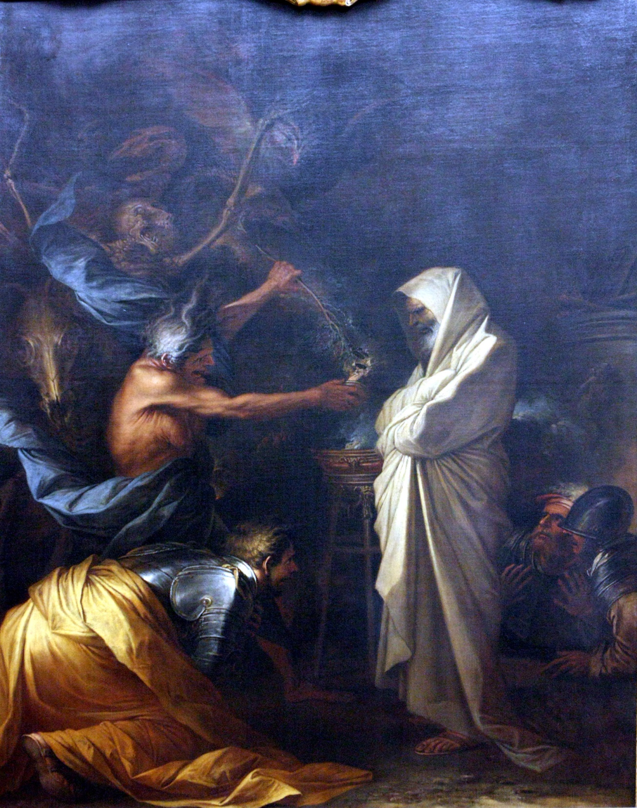
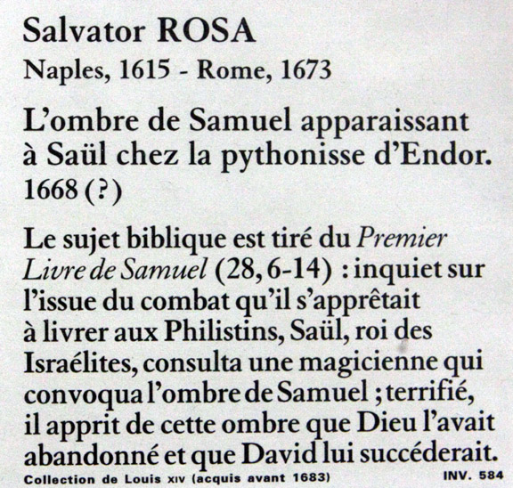

Slide 10
^{97:1.5} ^{(1063.2)} And he preached anew the story of God's sincerity, his covenant-keeping reliability. Said Samuel: " The Lord will not forsake his people. " " He has made with us an everlasting covenant, ordered in all things and sure. " And so, throughout all Palestine there sounded the call back to the worship of the supreme Yahweh. Ever this energetic teacher proclaimed, " You are great, O Lord God, for there is none like you, neither is there any God beside you. "

Slide 11
^{97:1.6} ^{(1063.3)} Theretofore the Hebrews had regarded the favor of Yahweh mainly in terms of material prosperity. It was a great shock to Israel, and almost cost Samuel his life, when he dared to proclaim: " The Lord enriches and impoverishes; he debases and exalts. He raises the poor out of the dust and lifts up the beggars to set them among princes to make them inherit the throne of glory. " Not since Moses had such comforting promises for the humble and the less fortunate been proclaimed, and thousands of despairing among the poor began to take hope that they could improve their spiritual status.

Slide 12
^{97:1.7} ^{(1063.4)} But Samuel did not progress very far beyond the concept of a tribal god. He proclaimed a Yahweh who made all men but was occupied chiefly with the Hebrews, his chosen people. Even so, as in the days of Moses, once more the God concept portrayed a Deity who is holy and upright. " There is none as holy as the Lord. Who can be compared to this holy Lord God? "

Slide 13
^{97:1.8} ^{(1063.5)} As the years passed, the grizzled old leader progressed in the understanding of God, for he declared: " The Lord is a God of knowledge, and actions are weighed by him. The Lord will judge the ends of the earth, showing mercy to the merciful, and with the upright man he will also be upright. " Even here is the dawn of mercy, albeit it is limited to those who are merciful. Later he went one step further when, in their adversity, he exhorted his people: " Let us fall now into the hands of the Lord, for his mercies are great. " " There is no restraint upon the Lord to save many or few. "

Slide 14
^{97:1.9} ^{(1063.6)} And this gradual development of the concept of the character of Yahweh continued under the ministry of Samuel's successors. They attempted to present Yahweh as a covenant-keeping God but hardly maintained the pace set by Samuel; they failed to develop the idea of the mercy of God as Samuel had later conceived it. There was a steady drift back toward the recognition of other gods, despite the maintenance that Yahweh was above all. " Yours is the kingdom, O Lord, and you are exalted as head above all. "

Slide 15
^{97:1.10} ^{(1064.1)} The keynote of this era was divine power; the prophets of this age preached a religion designed to foster the king upon the Hebrew throne. " Yours, O Lord, is the greatness and the power and the glory and the victory and the majesty. In your hand is power and might, and you are able to make great and to give strength to all. " And this was the status of the God concept during the time of Samuel and his immediate successors.

Slide 16
2. Elijah and Elisha AUDIO VERSION
^{97:2.1} ^{(1064.2)} In the tenth century before Christ the Hebrew nation became divided into two kingdoms. In both of these political divisions many truth teachers endeavored to stem the reactionary tide of spiritual decadence that had set in, and which continued disastrously after the war of separation. But these efforts to advance the Hebraic religion did not prosper until that determined and fearless warrior for righteousness, Elijah, began his teaching. Elijah restored to the northern kingdom a concept of God comparable with that held in the days of Samuel. Elijah had little opportunity to present an advanced concept of God; he was kept busy, as Samuel had been before him, overthrowing the altars of Baal and demolishing the idols of false gods. And he carried forward his reforms in the face of the opposition of an idolatrous monarch; his task was even more gigantic and difficult than that which Samuel had faced.

Slide 17
^{97:2.2} ^{(1064.3)} When Elijah was called away, Elisha, his faithful associate, took up his work and, with the invaluable assistance of the little-known Micaiah, kept the light of truth alive in Palestine.

Slide 18
^{97:2.3} ^{(1064.4)} But these were not times of progress in the concept of Deity. Not yet had the Hebrews ascended even to the Mosaic ideal. The era of Elijah and Elisha closed with the better classes returning to the worship of the supreme Yahweh and witnessed the restoration of the idea of the Universal Creator to about that place where Samuel had left it.

Slide 19
3. Yahweh and Baal AUDIO VERSION
^{97:3.1} ^{(1064.5)} The long-drawn-out controversy between the believers in Yahweh and the followers of Baal was a socioeconomic clash of ideologies rather than a difference in religious beliefs.

Slide 20
^{97:3.2} ^{(1064.6)} The inhabitants of Palestine differed in their attitude toward private ownership of land. The southern or wandering Arabian tribes (the Yahwehites) looked upon land as an inalienable—as a gift of Deity to the clan. They held that land could not be sold or mortgaged. " Yahweh spoke, saying, `The land shall not be sold, for the land is mine.' "

Slide 21
^{97:3.3} ^{(1064.7)} The northern and more settled Canaanites (the Baalites) freely bought, sold, and mortgaged their lands. The word Baal means owner. The Baal cult was founded on two major doctrines: First, the validation of property exchange, contracts, and covenants—the right to buy and sell land. Second, Baal was supposed to send rain—he was a god of fertility of the soil. Good crops depended on the favor of Baal. The cult was largely concerned with land, its ownership and fertility.

Slide 22
^{97:3.4} ^{(1065.1)} In general, the Baalites owned houses, lands, and slaves. They were the aristocratic landlords and lived in the cities. Each Baal had a sacred place, a priesthood, and the " holy women, " the ritual prostitutes.

Slide 23
^{97:3.5} ^{(1065.2)} Out of this basic difference in the regard for land, there evolved the bitter antagonisms of social, economic, moral, and religious attitudes exhibited by the Canaanites and the Hebrews. This socioeconomic controversy did not become a definite religious issue until the times of Elijah. From the days of this aggressive prophet the issue was fought out on more strictly religious lines—Yahweh vs. Baal—and it ended in the triumph of Yahweh and the subsequent drive toward monotheism.

Slide 24
^{97:3.6} ^{(1065.3)} Elijah shifted the Yahweh-Baal controversy from the land issue to the religious aspect of Hebrew and Canaanite ideologies. When Ahab murdered the Naboths in the intrigue to get possession of their land, Elijah made a moral issue out of the olden land mores and launched his vigorous campaign against the Baalites. This was also a fight of the country folk against domination by the cities. It was chiefly under Elijah that Yahweh became Elohim. The prophet began as an agrarian reformer and ended up by exalting Deity. Baals were many, Yahweh was one —monotheism won over polytheism.

Slide 25
4. Amos and Hosea AUDIO VERSION
^{97:4.1} ^{(1065.4)} A great step in the transition of the tribal god—the god who had so long been served with sacrifices and ceremonies, the Yahweh of the earlier Hebrews—to a God who would punish crime and immorality among even his own people, was taken by Amos, who appeared from among the southern hills to denounce the criminality, drunkenness, oppression, and immorality of the northern tribes. Not since the times of Moses had such ringing truths been proclaimed in Palestine.

Slide 26
^{97:4.2} ^{(1065.5)} Amos was not merely a restorer or reformer; he was a discoverer of new concepts of Deity. He proclaimed much about God that had been announced by his predecessors and courageously attacked the belief in a Divine Being who would countenance sin among his so-called chosen people. For the first time since the days of Melchizedek the ears of man heard the denunciation of the double standard of national justice and morality. For the first time in their history Hebrew ears heard that their own God, Yahweh, would no more tolerate crime and sin in their lives than he would among any other people. Amos envisioned the stern and just God of Samuel and Elijah, but he also saw a God who thought no differently of the Hebrews than of any other nation when it came to the punishment of wrongdoing. This was a direct attack on the egoistic doctrine of the " chosen people, " and many Hebrews of those days bitterly resented it.

Slide 27
^{97:4.3} ^{(1065.6)} Said Amos: " He who formed the mountains and created the wind, seek him who formed the seven stars and Orion, who turns the shadow of death into the morning and makes the day dark as night. " And in denouncing his half-religious, timeserving, and sometimes immoral fellows, he sought to portray the inexorable justice of an unchanging Yahweh when he said of the evildoers: " Though they dig into hell, thence shall I take them; though they climb up to heaven, thence will I bring them down. " " And though they go into captivity before their enemies, thence will I direct the sword of justice, and it shall slay them. " Amos further startled his hearers when, pointing a reproving and accusing finger at them, he declared in the name of Yahweh: " Surely I will never forget any of your works. " " And I will sift the house of Israel among all nations as wheat is sifted in a sieve. "

Slide 28
^{97:4.4} ^{(1066.1)} Amos proclaimed Yahweh the " God of all nations " and warned the Israelites that ritual must not take the place of righteousness. And before this courageous teacher was stoned to death, he had spread enough leaven of truth to save the doctrine of the supreme Yahweh; he had insured the further evolution of the Melchizedek revelation.

Slide 29
^{97:4.5} ^{(1066.2)} Hosea followed Amos and his doctrine of a universal God of justice by the resurrection of the Mosaic concept of a God of love. Hosea preached forgiveness through repentance, not by sacrifice. He proclaimed a gospel of loving-kindness and divine mercy, saying: " I will betroth you to me forever; yes, I will betroth you to me in righteousness and judgment and in loving-kindness and in mercies. I will even betroth you to me in faithfulness. " " I will love them freely, for my anger is turned away. "

Slide 30
^{97:4.6} ^{(1066.3)} Hosea faithfully continued the moral warnings of Amos, saying of God, " It is my desire that I chastise them. " But the Israelites regarded it as cruelty bordering on treason when he said: " I will say to those who were not my people, `you are my people'; and they will say, `you are our God.' " He continued to preach repentance and forgiveness, saying, " I will heal their backsliding; I will love them freely, for my anger is turned away. " Always Hosea proclaimed hope and forgiveness. The burden of his message ever was: " I will have mercy upon my people. They shall know no God but me, for there is no savior beside me. "

Slide 31
^{97:4.7} ^{(1066.4)} Amos quickened the national conscience of the Hebrews to the recognition that Yahweh would not condone crime and sin among them because they were supposedly the chosen people, while Hosea struck the opening notes in the later merciful chords of divine compassion and loving-kindness which were so exquisitely sung by Isaiah and his associates.

Slide 32
5. The First Isaiah AUDIO VERSION
^{97:5.1} ^{(1066.5)} These were the times when some were proclaiming threatenings of punishment against personal sins and national crime among the northern clans while others predicted calamity in retribution for the transgressions of the southern kingdom. It was in the wake of this arousal of conscience and consciousness in the Hebrew nations that the first Isaiah made his appearance.

Slide 33
^{97:5.2} ^{(1066.6)} Isaiah went on to preach the eternal nature of God, his infinite wisdom, his unchanging perfection of reliability. He represented the God of Israel as saying: " Judgment also will I lay to the line and righteousness to the plummet. " " The Lord will give you rest from your sorrow and from your fear and from the hard bondage wherein man has been made to serve. " " And your ears shall hear a word behind you, saying, `this is the way, walk in it.' " " Behold God is my salvation; I will trust and not be afraid, for the Lord is my strength and my song. " " `Come now and let us reason together,' says the Lord, `though your sins be as scarlet, they shall be as white as snow; though they be red like the crimson, they shall be as wool.' "

Slide 34
^{97:5.3} ^{(1066.7)} Speaking to the fear-ridden and soul-hungry Hebrews, this prophet said: " Arise and shine, for your light has come, and the glory of the Lord has risen upon you. " " The spirit of the Lord is upon me because he has anointed me to preach good tidings to the meek; he has sent me to bind up the brokenhearted, to proclaim liberty to the captives and the opening of the prison to those who are bound. " " I will greatly rejoice in the Lord, my soul shall be joyful in my God, for he has clothed me with the garments of salvation and has covered me with his robe of righteousness. " " In all their afflictions he was afflicted, and the angel of his presence saved them. In his love and in his pity he redeemed them. "

Slide 35
^{97:5.4} ^{(1067.1)} This Isaiah was followed by Micah and Obadiah, who confirmed and embellished his soul-satisfying gospel. And these two brave messengers boldly denounced the priest-ridden ritual of the Hebrews and fearlessly attacked the whole sacrificial system.

Slide 36
^{97:5.5} ^{(1067.2)} Micah denounced " the rulers who judge for reward and the priests who teach for hire and the prophets who divine for money. " He taught of a day of freedom from superstition and priestcraft, saying: " But every man shall sit under his own vine, and no one shall make him afraid, for all people will live, each one according to his understanding of God. "

Slide 37
^{97:5.6} ^{(1067.3)} Ever the burden of Micah's message was: " Shall I come before God with burnt offerings? Will the Lord be pleased with a thousand rams or with ten thousand rivers of oil? Shall I give my first-born for my transgression, the fruit of my body for the sin of my soul? He has shown me, O man, what is good; and what does the Lord require of you but to do justly and to love mercy and to walk humbly with your God. " And it was a great age; these were indeed stirring times when mortal man heard, and some even believed, such emancipating messages more than two and a half millenniums ago. And but for the stubborn resistance of the priests, these teachers would have overthrown the whole bloody ceremonial of the Hebrew ritual of worship. *

Slide 38
6. Jeremiah the Fearless AUDIO VERSION
^{97:6.1} ^{(1067.4)} While several teachers continued to expound the gospel of Isaiah, it remained for Jeremiah to take the next bold step in the internationalization of Yahweh, God of the Hebrews.

Slide 39
^{97:6.2} ^{(1067.5)} Jeremiah fearlessly declared that Yahweh was not on the side of the Hebrews in their military struggles with other nations. He asserted that Yahweh was God of all the earth, of all nations and of all peoples. Jeremiah's teaching was the crescendo of the rising wave of the internationalization of the God of Israel; finally and forever did this intrepid preacher proclaim that Yahweh was God of all nations, and that there was no Osiris for the Egyptians, Bel for the Babylonians, Ashur for the Assyrians, or Dagon for the Philistines. And thus did the religion of the Hebrews share in that renaissance of monotheism throughout the world at about and following this time; at last the concept of Yahweh had ascended to a Deity level of planetary and even cosmic dignity. But many of Jeremiah's associates found it difficult to conceive of Yahweh apart from the Hebrew nation.

Slide 40
^{97:6.3} ^{(1067.6)} Jeremiah also preached of the just and loving God described by Isaiah, declaring: " Yes, I have loved you with an everlasting love; therefore with loving-kindness have I drawn you. " " For he does not afflict willingly the children of men. "

Slide 41
^{97:6.4} ^{(1067.7)} Said this fearless prophet: " Righteous is our Lord, great in counsel and mighty in work. His eyes are open upon all the ways of all the sons of men, to give every one according to his ways and according to the fruit of his doings. " But it was considered blasphemous treason when, during the siege of Jerusalem, he said: " And now have I given these lands into the hand of Nebuchadnezzar, the king of Babylon, my servant. " And when Jeremiah counseled the surrender of the city, the priests and civil rulers cast him into the miry pit of a dismal dungeon.

Slide 42
7. The Second Isaiah AUDIO VERSION
^{97:7.1} ^{(1068.1)} The destruction of the Hebrew nation and their captivity in Mesopotamia would have proved of great benefit to their expanding theology had it not been for the determined action of their priesthood. Their nation had fallen before the armies of Babylon, and their nationalistic Yahweh had suffered from the international preachments of the spiritual leaders. It was resentment of the loss of their national god that led the Jewish priests to go to such lengths in the invention of fables and the multiplication of miraculous appearing events in Hebrew history in an effort to restore the Jews as the chosen people of even the new and expanded idea of an internationalized God of all nations.

Slide 43
^{97:7.2} ^{(1068.2)} During the captivity the Jews were much influenced by Babylonian traditions and legends, although it should be noted that they unfailingly improved the moral tone and spiritual significance of the Chaldean stories which they adopted, notwithstanding that they invariably distorted these legends to reflect honor and glory upon the ancestry and history of Israel.

Slide 44
^{97:7.3} ^{(1068.3)} These Hebrew priests and scribes had a single idea in their minds, and that was the rehabilitation of the Jewish nation, the glorification of Hebrew traditions, and the exaltation of their racial history. If there is resentment of the fact that these priests have fastened their erroneous ideas upon such a large part of the Occidental world, it should be remembered that they did not intentionally do this; they did not claim to be writing by inspiration; they made no profession to be writing a sacred book. They were merely preparing a textbook designed to bolster up the dwindling courage of their fellows in captivity. They were definitely aiming at improving the national spirit and morale of their compatriots. It remained for later-day men to assemble these and other writings into a guide book of supposedly infallible teachings.

Slide 45
^{97:7.4} ^{(1068.4)} The Jewish priesthood made liberal use of these writings subsequent to the captivity, but they were greatly hindered in their influence over their fellow captives by the presence of a young and indomitable prophet, Isaiah the second, who was a full convert to the elder Isaiah's God of justice, love, righteousness, and mercy. He also believed with Jeremiah that Yahweh had become the God of all nations. He preached these theories of the nature of God with such telling effect that he made converts equally among the Jews and their captors. And this young preacher left on record his teachings, which the hostile and unforgiving priests sought to divorce from all association with him, although sheer respect for their beauty and grandeur led to their incorporation among the writings of the earlier Isaiah. And thus may be found the writings of this second Isaiah in the book of that name, embracing chapters forty to fifty-five inclusive.

Slide 46
^{97:7.5} ^{(1068.5)} No prophet or religious teacher from Machiventa to the time of Jesus attained the high concept of God that Isaiah the second proclaimed during these days of the captivity. It was no small, anthropomorphic, man-made God that this spiritual leader proclaimed. " Behold he takes up the isles as a very little thing. " " And as the heavens are higher than the earth, so are my ways higher than your ways and my thoughts higher than your thoughts. "

Slide 47
^{97:7.6} ^{(1069.1)} At last Machiventa Melchizedek beheld human teachers proclaiming a real God to mortal man. Like Isaiah the first, this leader preached a God of universal creation and upholding. " I have made the earth and put man upon it. I have created it not in vain; I formed it to be inhabited. " " I am the first and the last; there is no God beside me. " Speaking for the Lord God of Israel, this new prophet said: " The heavens may vanish and the earth wax old, but my righteousness shall endure forever and my salvation from generation to generation. " " Fear you not, for I am with you; be not dismayed, for I am your God. " " There is no God beside me—a just God and a Savior. "

Slide 48
^{97:7.7} ^{(1069.2)} And it comforted the Jewish captives, as it has thousands upon thousands ever since, to hear such words as: " Thus says the Lord, `I have created you, I have redeemed you, I have called you by your name; you are mine.' " " When you pass through the waters, I will be with you since you are precious in my sight. " " Can a woman forget her suckling child that she should not have compassion on her son? Yes, she may forget, yet will I not forget my children, for behold I have graven them upon the palms of my hands; I have even covered them with the shadow of my hands. " " Let the wicked forsake his ways and the unrighteous man his thoughts, and let him return to the Lord, and he will have mercy upon him, and to our God, for he will abundantly pardon. "

Slide 49
^{97:7.8} ^{(1069.3)} Listen again to the gospel of this new revelation of the God of Salem: " He shall feed his flock like a shepherd; he shall gather the lambs in his arms and carry them in his bosom. He gives power to the faint, and to those who have no might he increases strength. Those who wait upon the Lord shall renew their strength; they shall mount up with wings as eagles; they shall run and not be weary; they shall walk and not faint. "

Slide 50
^{97:7.9} ^{(1069.4)} This Isaiah conducted a far-flung propaganda of the gospel of the enlarging concept of a supreme Yahweh. He vied with Moses in the eloquence with which he portrayed the Lord God of Israel as the Universal Creator. He was poetic in his portrayal of the infinite attributes of the Universal Father. No more beautiful pronouncements about the heavenly Father have ever been made. Like the Psalms, the writings of Isaiah are among the most sublime and true presentations of the spiritual concept of God ever to greet the ears of mortal man prior to the arrival of Michael on Urantia. Listen to his portrayal of Deity: " I am the high and lofty one who inhabits eternity. " " I am the first and the last, and beside me there is no other God. " " And the Lord's hand is not shortened that it cannot save, neither his ear heavy that it cannot hear. " And it was a new doctrine in Jewry when this benign but commanding prophet persisted in the preachment of divine constancy, God's faithfulness. He declared that " God would not forget, would not forsake. "

Slide 51
^{97:7.10} ^{(1069.5)} This daring teacher proclaimed that man was very closely related to God, saying: " Every one who is called by my name I have created for my glory, and they shall show forth my praise. I, even I, am he who blots out their transgressions for my own sake, and I will not remember their sins. "

Slide 52
^{97:7.11} ^{(1069.6)} Hear this great Hebrew demolish the concept of a national God while in glory he proclaims the divinity of the Universal Father, of whom he says, " The heavens are my throne, and the earth is my footstool. " And Isaiah's God was none the less holy, majestic, just, and unsearchable. The concept of the angry, vengeful, and jealous Yahweh of the desert Bedouins has almost vanished. A new concept of the supreme and universal Yahweh has appeared in the mind of mortal man, never to be lost to human view. The realization of divine justice has begun the destruction of primitive magic and biologic fear. At last, man is introduced to a universe of law and order and to a universal God of dependable and final attributes.

Slide 53
^{97:7.12} ^{(1070.1)} And this preacher of a supernal God never ceased to proclaim this God of love. " I dwell in the high and holy place, also with him who is of a contrite and humble spirit. " And still further words of comfort did this great teacher speak to his contemporaries: " And the Lord will guide you continually and satisfy your soul. You shall be like a watered garden and like a spring whose waters fail not. And if the enemy shall come in like a flood, the spirit of the Lord will lift up a defense against him. " And once again did the fear-destroying gospel of Melchizedek and the trust-breeding religion of Salem shine forth for the blessing of mankind.

Slide 54
^{97:7.13} ^{(1070.2)} The farseeing and courageous Isaiah effectively eclipsed the nationalistic Yahweh by his sublime portraiture of the majesty and universal omnipotence of the supreme Yahweh, God of love, ruler of the universe, and affectionate Father of all mankind. Ever since those eventful days the highest God concept in the Occident has embraced universal justice, divine mercy, and eternal righteousness. In superb language and with matchless grace this great teacher portrayed the all-powerful Creator as the all-loving Father.

Slide 55
^{97:7.14} ^{(1070.3)} This prophet of the captivity preached to his people and to those of many nations as they listened by the river in Babylon. And this second Isaiah did much to counteract the many wrong and racially egoistic concepts of the mission of the promised Messiah. But in this effort he was not wholly successful. Had the priests not dedicated themselves to the work of building up a misconceived nationalism, the teachings of the two Isaiahs would have prepared the way for the recognition and reception of the promised Messiah.

Slide 56
8. Sacred and Profane History AUDIO VERSION
^{97:8.1} ^{(1070.4)} The custom of looking upon the record of the experiences of the Hebrews as sacred history and upon the transactions of the rest of the world as profane history is responsible for much of the confusion existing in the human mind as to the interpretation of history. And this difficulty arises because there is no secular history of the Jews. After the priests of the Babylonian exile had prepared their new record of God's supposedly miraculous dealings with the Hebrews, the sacred history of Israel as portrayed in the Old Testament, they carefully and completely destroyed the existing records of Hebrew affairs—such books as " The Doings of the Kings of Israel " and " The Doings of the Kings of Judah, " together with several other more or less accurate records of Hebrew history.

Slide 57
^{97:8.2} ^{(1070.5)} In order to understand how the devastating pressure and the inescapable coercion of secular history so terrorized the captive and alien-ruled Jews that they attempted the complete rewriting and recasting of their history, we should briefly survey the record of their perplexing national experience. It must be remembered that the Jews failed to evolve an adequate nontheologicphilosophy of life. They struggled with their original and Egyptian concept of divine rewards for righteousness coupled with dire punishments for sin. The drama of Job was something of a protest against this erroneous philosophy. The frank pessimism of Ecclesiastes was a worldly wise reaction to these overoptimistic beliefs in Providence.

Slide 58
^{97:8.3} ^{(1071.1)} But five hundred years of the overlordship of alien rulers was too much for even the patient and long-suffering Jews. The prophets and priests began to cry: " How long, O Lord, how long? " As the honest Jew searched the Scriptures, his confusion became worse confounded. An olden seer promised that God would protect and deliver his " chosen people. " Amos had threatened that God would abandon Israel unless they re-established their standards of national righteousness. The scribe of Deuteronomy had portrayed the Great Choice—as between the good and the evil, the blessing and the curse. Isaiah the first had preached a beneficent king-deliverer. Jeremiah had proclaimed an era of inner righteousness—the covenant written on the tablets of the heart. The second Isaiah talked about salvation by sacrifice and redemption. Ezekiel proclaimed deliverance through the service of devotion, and Ezra promised prosperity by adherence to the law. But in spite of all this they lingered on in bondage, and deliverance was deferred. Then Daniel presented the drama of the impending " crisis "—the smiting of the great image and the immediate establishment of the everlasting reign of righteousness, the Messianic kingdom.

Slide 59
^{97:8.4} ^{(1071.2)} And all of this false hope led to such a degree of racial disappointment and frustration that the leaders of the Jews were so confused they failed to recognize and accept the mission and ministry of a divine Son of Paradise when he presently came to them in the likeness of mortal flesh—incarnated as the Son of Man.

Slide 60
^{97:8.5} ^{(1071.3)} All modern religions have seriously blundered in the attempt to put a miraculous interpretation on certain epochs of human history. While it is true that God has many times thrust a Father's hand of providential intervention into the stream of human affairs, it is a mistake to regard theologic dogmas and religious superstition as a supernatural sedimentation appearing by miraculous action in this stream of human history. The fact that the " Most Highs rule in the kingdoms of men " does not convert secular history into so-called sacred history.

Slide 61
^{97:8.6} ^{(1071.4)} New Testament authors and later Christian writers further complicated the distortion of Hebrew history by their well-meant attempts to transcendentalize the Jewish prophets. Thus has Hebrew history been disastrously exploited by both Jewish and Christian writers. Secular Hebrew history has been thoroughly dogmatized. It has been converted into a fiction of sacred history and has become inextricably bound up with the moral concepts and religious teachings of the so-called Christian nations.

Slide 62
^{97:8.7} ^{(1071.5)} A brief recital of the high points in Hebrew history will illustrate how the facts of the record were so altered in Babylon by the Jewish priests as to turn the everyday secular history of their people into a fictitious and sacred history.

Slide 63
9. Hebrew History AUDIO VERSION
^{97:9.1} ^{(1071.6)} There never were twelve tribes of the Israelites—only three or four tribes settled in Palestine. The Hebrew nation came into being as the result of the union of the so-called Israelites and the Canaanites. " And the children of Israel dwelt among the Canaanites. And they took their daughters to be their wives and gave their daughters to the sons of the Canaanites. " The Hebrews never drove the Canaanites out of Palestine, notwithstanding that the priests' record of these things unhesitatingly declared that they did.

Slide 64
^{97:9.2} ^{(1071.7)} The Israelitish consciousness took origin in the hill country of Ephraim; the later Jewish consciousness originated in the southern clan of Judah. The Jews (Judahites) always sought to defame and blacken the record of the northern Israelites (Ephraimites).

Slide 65
^{97:9.3} ^{(1072.1)} Pretentious Hebrew history begins with Saul's rallying the northern clans to withstand an attack by the Ammonites upon their fellow tribesmen—the Gileadites—east of the Jordan. With an army of a little more than three thousand he defeated the enemy, and it was this exploit that led the hill tribes to make him king. When the exiled priests rewrote this story, they raised Saul's army to 330,000 and added " Judah " to the list of tribes participating in the battle.

Slide 66
^{97:9.4} ^{(1072.2)} Immediately following the defeat of the Ammonites, Saul was made king by popular election by his troops. No priest or prophet participated in this affair. But the priests later on put it in the record that Saul was crowned king by the prophet Samuel in accordance with divine directions. This they did in order to establish a " divine line of descent " for David's Judahite kingship.

Slide 67
^{97:9.5} ^{(1072.3)} The greatest of all distortions of Jewish history had to do with David. After Saul's victory over the Ammonites (which he ascribed to Yahweh) the Philistines became alarmed and began attacks on the northern clans. David and Saul never could agree. David with six hundred men entered into a Philistine alliance and marched up the coast to Esdraelon. At Gath the Philistines ordered David off the field; they feared he might go over to Saul. David retired; the Philistines attacked and defeated Saul. They could not have done this had David been loyal to Israel. David's army was a polyglot assortment of malcontents, being for the most part made up of social misfits and fugitives from justice.

Slide 68
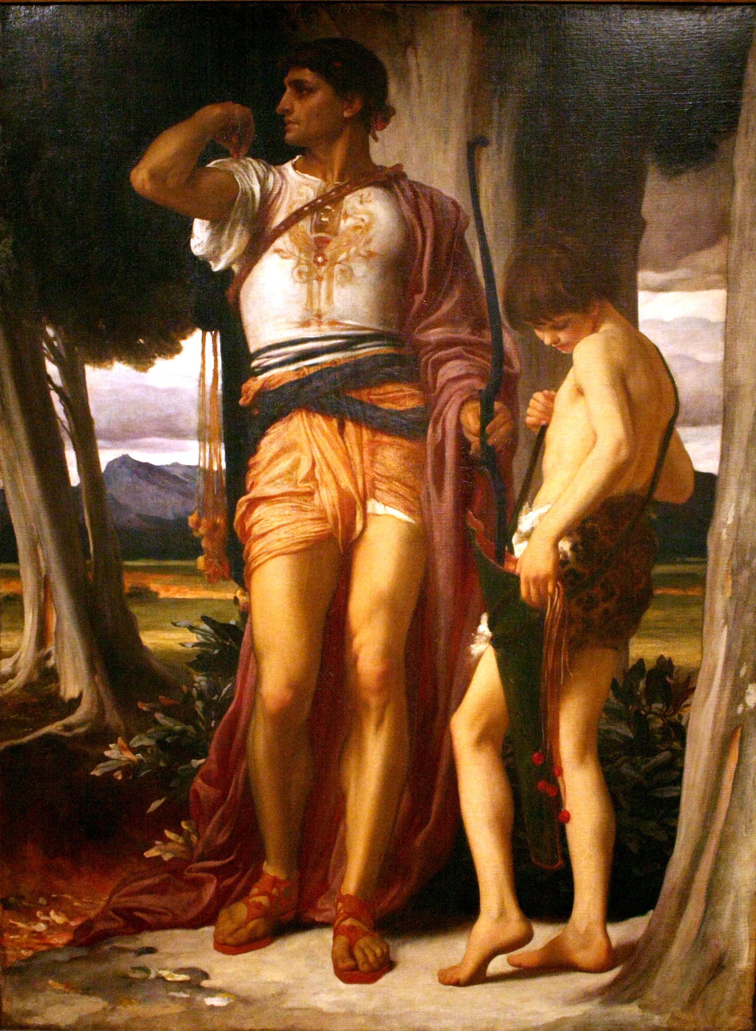
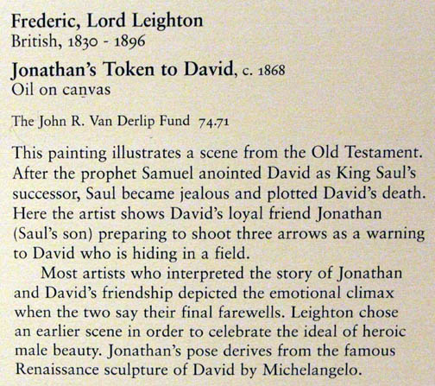

Slide 69
^{97:9.6} ^{(1072.4)} Saul's tragic defeat at Gilboa by the Philistines brought Yahweh to a low point among the gods in the eyes of the surrounding Canaanites. Ordinarily, Saul's defeat would have been ascribed to apostasy from Yahweh, but this time the Judahite editors attributed it to ritual errors. They required the tradition of Saul and Samuel as a background for the kingship of David.

Slide 70
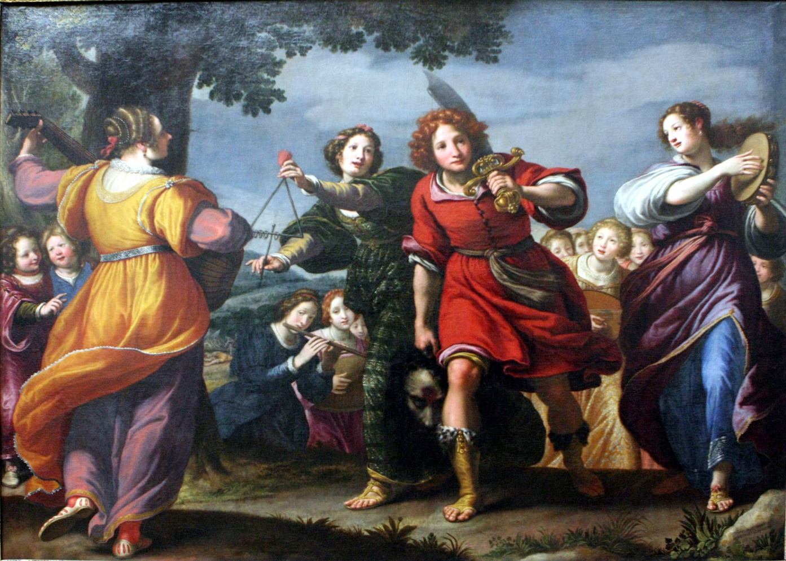
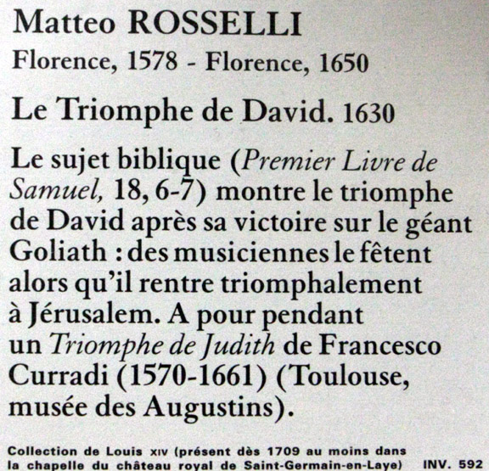

Slide 71
^{97:9.7} ^{(1072.5)} David with his small army made his headquarters at the non-Hebrew city of Hebron. Presently his compatriots proclaimed him king of the new kingdom of Judah. Judah was made up mostly of non-Hebrew elements—Kenites, Calebites, Jebusites, and other Canaanites. They were nomads—herders—and so were devoted to the Hebrew idea of land ownership. They held the ideologies of the desert clans.

Slide 72
^{97:9.8} ^{(1072.6)} The difference between sacred and profane history is well illustrated by the two differing stories concerning making David king as they are found in the Old Testament. A part of the secular story of how his immediate followers (his army) made him king was inadvertently left in the record by the priests who subsequently prepared the lengthy and prosaic account of the sacred history wherein is depicted how the prophet Samuel, by divine direction, selected David from among his brethren and proceeded formally and by elaborate and solemn ceremonies to anoint him king over the Hebrews and then to proclaim him Saul's successor.

Slide 73
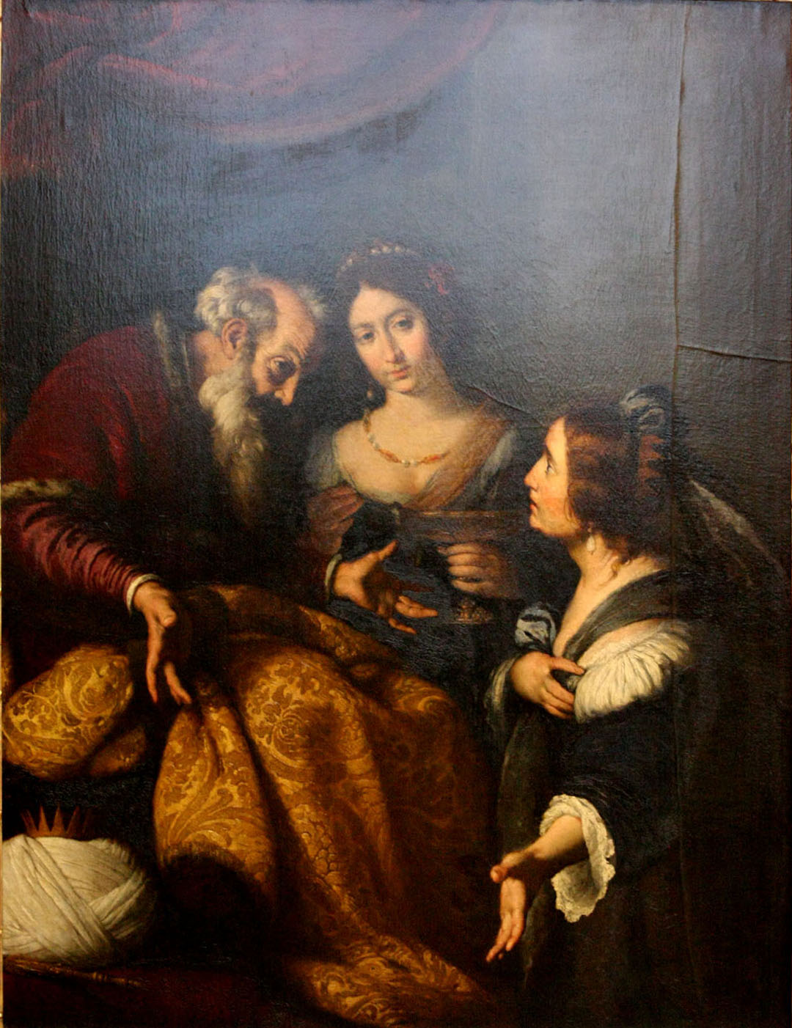

Slide 74
^{97:9.9} ^{(1072.7)} So many times did the priests, after preparing their fictitious narratives of God's miraculous dealings with Israel, fail fully to delete the plain and matter-of-fact statements which already rested in the records.

Slide 75
^{97:9.10} ^{(1072.8)} David sought to build himself up politically by first marrying Saul's daughter, then the widow of Nabal the rich Edomite, and then the daughter of Talmai, the king of Geshur. He took six wives from the women of Jebus, not to mention Bathsheba, the wife of the Hittite.

Slide 76
^{97:9.11} ^{(1073.1)} And it was by such methods and out of such people that David built up the fiction of a divine kingdom of Judah as the successor of the heritage and traditions of the vanishing northern kingdom of Ephraimite Israel. David's cosmopolitan tribe of Judah was more gentile than Jewish; nevertheless the oppressed elders of Ephraim came down and " anointed him king of Israel. " After a military threat, David then made a compact with the Jebusites and established his capital of the united kingdom at Jebus (Jerusalem), which was a strong-walled city midway between Judah and Israel. The Philistines were aroused and soon attacked David. After a fierce battle they were defeated, and once more Yahweh was established as " The Lord God of Hosts. "

Slide 77
^{97:9.12} ^{(1073.2)} But Yahweh must, perforce, share some of this glory with the Canaanite gods, for the bulk of David's army was non-Hebrew. And so there appears in your record (overlooked by the Judahite editors) this telltale statement: " Yahweh has broken my enemies before me. Therefore he called the name of the place Baal-Perazim. " And they did this because eighty per cent of David's soldiers were Baalites.

Slide 78
^{97:9.13} ^{(1073.3)} David explained Saul's defeat at Gilboa by pointing out that Saul had attacked a Canaanite city, Gibeon, whose people had a peace treaty with the Ephraimites. Because of this, Yahweh forsook him. Even in Saul's time David had defended the Canaanite city of Keilah against the Philistines, and then he located his capital in a Canaanite city. In keeping with the policy of compromise with the Canaanites, David turned seven of Saul's descendants over to the Gibeonites to be hanged.

Slide 79
^{97:9.14} ^{(1073.4)} After the defeat of the Philistines, David gained possession of the " ark of Yahweh, " brought it to Jerusalem, and made the worship of Yahweh official for his kingdom. He next laid heavy tribute on the neighboring tribes—the Edomites, Moabites, Ammonites, and Syrians.

Slide 80
^{97:9.15} ^{(1073.5)} David's corrupt political machine began to get personal possession of land in the north in violation of the Hebrew mores and presently gained control of the caravan tariffs formerly collected by the Philistines. And then came a series of atrocities climaxed by the murder of Uriah. All judicial appeals were adjudicated at Jerusalem; no longer could " the elders " mete out justice. No wonder rebellion broke out. Today, Absalom might be called a demagogue; his mother was a Canaanite. There were a half dozen contenders for the throne besides the son of Bathsheba—Solomon.

Slide 81
^{97:9.16} ^{(1073.6)} After David's death Solomon purged the political machine of all northern influences but continued all of the tyranny and taxation of his father's regime. Solomon bankrupted the nation by his lavish court and by his elaborate building program: There was the house of Lebanon, the palace of Pharaoh's daughter, the temple of Yahweh, the king's palace, and the restoration of the walls of many cities. Solomon created a vast Hebrew navy, operated by Syrian sailors and trading with all the world. His harem numbered almost one thousand.

Slide 82
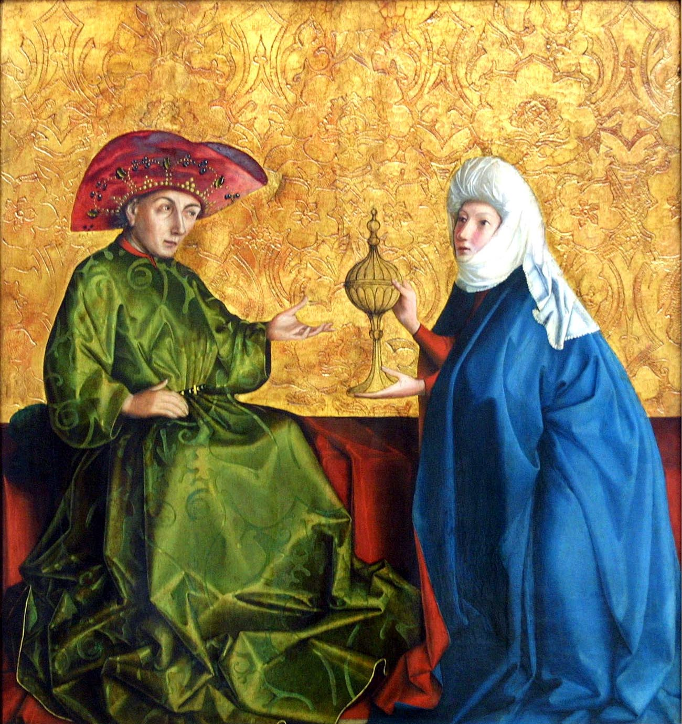

Slide 83
^{97:9.17} ^{(1073.7)} By this time Yahweh's temple at Shiloh was discredited, and all the worship of the nation was centered at Jebus in the gorgeous royal chapel. The northern kingdom returned more to the worship of Elohim. They enjoyed the favor of the Pharaohs, who later enslaved Judah, putting the southern kingdom under tribute.

Slide 84
^{97:9.18} ^{(1073.8)} There were ups and downs—wars between Israel and Judah. After four years of civil war and three dynasties, Israel fell under the rule of city despots who began to trade in land. Even King Omri attempted to buy Shemer's estate. But the end drew on apace when Shalmaneser III decided to control the Mediterranean coast. King Ahab of Ephraim gathered ten other groups and resisted at Karkar; the battle was a draw. The Assyrian was stopped but the allies were decimated. This great fight is not even mentioned in the Old Testament.

Slide 85
^{97:9.19} ^{(1074.1)} New trouble started when King Ahab tried to buy land from Naboth. His Phoenician wife forged Ahab's name to papers directing that Naboth's land be confiscated on the charge that he had blasphemed the names of " Elohim and the king. " He and his sons were promptly executed. The vigorous Elijah appeared on the scene denouncing Ahab for the murder of the Naboths. Thus Elijah, one of the greatest of the prophets, began his teaching as a defender of the old land mores as against the land-selling attitude of the Baalim, against the attempt of the cities to dominate the country. But the reform did not succeed until the country landlord Jehu joined forces with the gypsy chieftain Jehonadab to destroy the prophets (real estate agents) of Baal at Samaria.

Slide 86
^{97:9.20} ^{(1074.2)} New life appeared as Jehoash and his son Jeroboam delivered Israel from its enemies. But by this time there ruled in Samaria a gangster-nobility whose depredations rivaled those of the Davidic dynasty of olden days. State and church went along hand in hand. The attempt to suppress freedom of speech led Elijah, Amos, and Hosea to begin their secret writing, and this was the real beginning of the Jewish and Christian Bibles.

Slide 87
^{97:9.21} ^{(1074.3)} But the northern kingdom did not vanish from history until the king of Israel conspired with the king of Egypt and refused to pay further tribute to Assyria. Then began the three years' siege followed by the total dispersion of the northern kingdom. Ephraim (Israel) thus vanished. Judah—the Jews, the " remnant of Israel "—had begun the concentration of land in the hands of the few, as Isaiah said, " Adding house to house and field to field. " Presently there was in Jerusalem a temple of Baal alongside the temple of Yahweh. This reign of terror was ended by a monotheistic revolt led by the boy king Joash, who crusaded for Yahweh for thirty-five years.

Slide 88
^{97:9.22} ^{(1074.4)} The next king, Amaziah, had trouble with the revolting tax-paying Edomites and their neighbors. After a signal victory he turned to attack his northern neighbors and was just as signally defeated. Then the rural folk revolted; they assassinated the king and put his sixteen-year-old son on the throne. This was Azariah, called Uzziah by Isaiah. After Uzziah, things went from bad to worse, and Judah existed for a hundred years by paying tribute to the kings of Assyria. Isaiah the first told them that Jerusalem, being the city of Yahweh, would never fall. But Jeremiah did not hesitate to proclaim its downfall.

Slide 89
^{97:9.23} ^{(1074.5)} The real undoing of Judah was effected by a corrupt and rich ring of politicians operating under the rule of a boy king, Manasseh. The changing economy favored the return of the worship of Baal, whose private land dealings were against the ideology of Yahweh. The fall of Assyria and the ascendency of Egypt brought deliverance to Judah for a time, and the country folk took over. Under Josiah they destroyed the Jerusalem ring of corrupt politicians. *

Slide 90
^{97:9.24} ^{(1074.6)} But this era came to a tragic end when Josiah presumed to go out to intercept Necho's mighty army as it moved up the coast from Egypt for the aid of Assyria against Babylon. He was wiped out, and Judah went under tribute to Egypt. The Baal political party returned to power in Jerusalem, and thus began the real Egyptian bondage. Then ensued a period in which the Baalim politicians controlled both the courts and the priesthood. Baal worship was an economic and social system dealing with property rights as well as having to do with soil fertility.

Slide 91
^{97:9.25} ^{(1075.1)} With the overthrow of Necho by Nebuchadnezzar, Judah fell under the rule of Babylon and was given ten years of grace, but soon rebelled. When Nebuchadnezzar came against them, the Judahites started social reforms, such as releasing slaves, to influence Yahweh. When the Babylonian army temporarily withdrew, the Hebrews rejoiced that their magic of reform had delivered them. It was during this period that Jeremiah told them of the impending doom, and presently Nebuchadnezzar returned.

Slide 92
^{97:9.26} ^{(1075.2)} And so the end of Judah came suddenly. The city was destroyed, and the people were carried away into Babylon. The Yahweh-Baal struggle ended with the captivity. And the captivity shocked the remnant of Israel into monotheism.

Slide 93
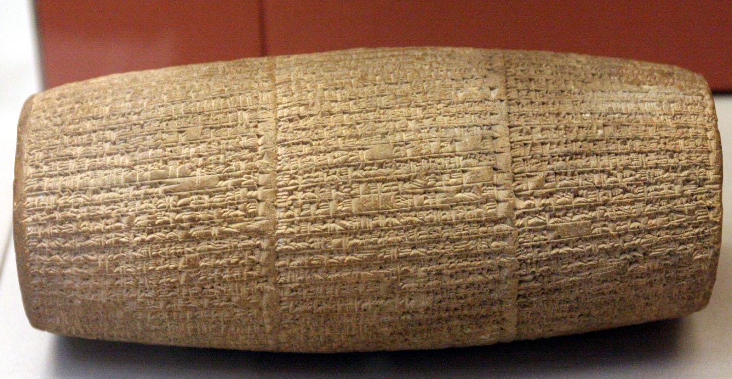
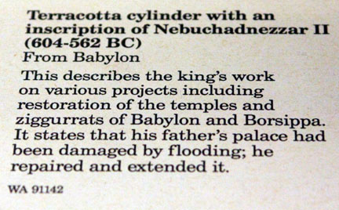

Slide 94
^{97:9.27} ^{(1075.3)} In Babylon the Jews arrived at the conclusion that they could not exist as a small group in Palestine, having their own peculiar social and economic customs, and that, if their ideologies were to prevail, they must convert the gentiles. Thus originated their new concept of destiny—the idea that the Jews must become the chosen servants of Yahweh. The Jewish religion of the Old Testament really evolved in Babylon during the captivity.

Slide 95
^{97:9.28} ^{(1075.4)} The doctrine of immortality also took form at Babylon. The Jews had thought that the idea of the future life detracted from the emphasis of their gospel of social justice. Now for the first time theology displaced sociology and economics. Religion was taking shape as a system of human thought and conduct more and more to be separated from politics, sociology, and economics.

Slide 96
^{97:9.29} ^{(1075.5)} And so does the truth about the Jewish people disclose that much which has been regarded as sacred history turns out to be little more than the chronicle of ordinary profane history. Judaism was the soil out of which Christianity grew, but the Jews were not a miraculous people.

Slide 97
10. The Hebrew Religion AUDIO VERSION
^{97:10.1} ^{(1075.6)} Their leaders had taught the Israelites that they were a chosen people, not for special indulgence and monopoly of divine favor, but for the special service of carrying the truth of the one God over all to every nation. And they had promised the Jews that, if they would fulfill this destiny, they would become the spiritual leaders of all peoples, and that the coming Messiah would reign over them and all the world as the Prince of Peace.

Slide 98
^{97:10.2} ^{(1075.7)} When the Jews had been freed by the Persians, they returned to Palestine only to fall into bondage to their own priest-ridden code of laws, sacrifices, and rituals. And as the Hebrew clans rejected the wonderful story of God presented in the farewell oration of Moses for the rituals of sacrifice and penance, so did these remnants of the Hebrew nation reject the magnificent concept of the second Isaiah for the rules, regulations, and rituals of their growing priesthood.

Slide 99
^{97:10.3} ^{(1075.8)} National egotism, false faith in a misconceived promised Messiah, and the increasing bondage and tyranny of the priesthood forever silenced the voices of the spiritual leaders (excepting Daniel, Ezekiel, Haggai, and Malachi); and from that day to the time of John the Baptist all Israel experienced an increasing spiritual retrogression. But the Jews never lost the concept of theUniversal Father; even to the twentieth century after Christ they have continued to follow this Deity conception.

Slide 100
^{97:10.4} ^{(1076.1)} From Moses to John the Baptist there extended an unbroken line of faithful teachers who passed the monotheistic torch of light from one generation to another while they unceasingly rebuked unscrupulous rulers, denounced commercializing priests, and ever exhorted the people to adhere to the worship of the supreme Yahweh, the Lord God of Israel.

Slide 101
^{97:10.5} ^{(1076.2)} As a nation the Jews eventually lost their political identity, but the Hebrew religion of sincere belief in the one and universal God continues to live in the hearts of the scattered exiles. And this religion survives because it has effectively functioned to conserve the highest values of its followers. The Jewish religion did preserve the ideals of a people, but it failed to foster progress and encourage philosophic creative discovery in the realms of truth. The Jewish religion had many faults—it was deficient in philosophy and almost devoid of aesthetic qualities—but it did conserve moral values; therefore it persisted. The supreme Yahweh, as compared with other concepts of Deity, was clear-cut, vivid, personal, and moral.

Slide 102
^{97:10.6} ^{(1076.3)} The Jews loved justice, wisdom, truth, and righteousness as have few peoples, but they contributed least of all peoples to the intellectual comprehension and to the spiritual understanding of these divine qualities. Though Hebrew theology refused to expand, it played an important part in the development of two other world religions, Christianity and Mohammedanism.

Slide 103
^{97:10.7} ^{(1076.4)} The Jewish religion persisted also because of its institutions. It is difficult for religion to survive as the private practice of isolated individuals. This has ever been the error of the religious leaders: Seeing the evils of institutionalized religion, they seek to destroy the technique of group functioning. In place of destroying all ritual, they would do better to reform it. In this respect Ezekiel was wiser than his contemporaries; though he joined with them in insisting on personal moral responsibility, he also set about to establish the faithful observance of a superior and purified ritual.

Slide 104
^{97:10.8} ^{(1076.5)} And thus the successive teachers of Israel accomplished the greatest feat in the evolution of religion ever to be effected on Urantia: the gradual but continuous transformation of the barbaric concept of the savage demon Yahweh, the jealous and cruel spirit god of the fulminating Sinai volcano, to the later exalted and supernal concept of the supreme Yahweh, creator of all things and the loving and merciful Father of all mankind. And this Hebraic concept of God was the highest human visualization of the Universal Father up to that time when it was further enlarged and so exquisitely amplified by the personal teachings and life example of his Son, Michael of Nebadon.
^{97:10.9} ^{(1076.6)} [Presented by a Melchizedek of Nebadon. ]

Slide 105
Paper 98 - Th Melchizedek Teachings in the Occident

